Slide 1



Slide 2
Pricing Model
Payment Model
Liquide coins
1 coin = ₹1
Liquide One Subscription
Quarterly - ₹999
Annually - ₹7999

Slide 3
Total funding: $2.2 M (Pre-Seed)
Revenue: $203k (March 2022)
Net Profit: -$119k (March 2022)
Valuation: $9.85M (as on Jun 16,2022)

Slide 4
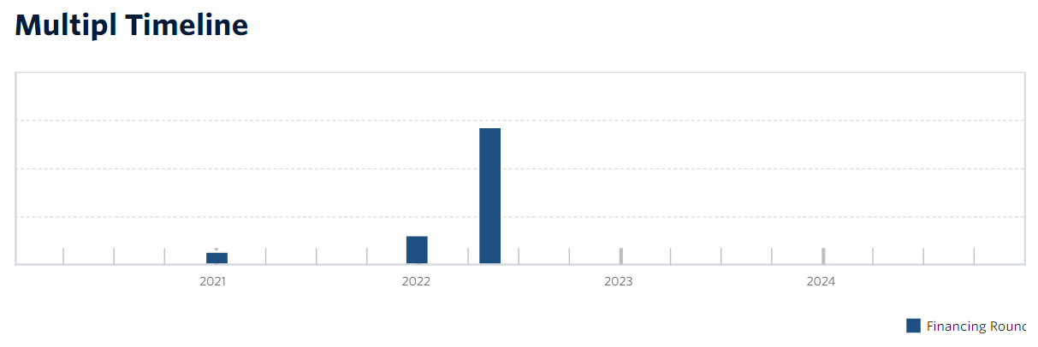
Tackling Buy Now Pay Later with Save Now, Pay Lesser
1k reviews

